Slide 1
Strategic Risk Analysis Report
Data Analytics Internship ApexPlanet . Software Pvt Ltd.
Presented by Shankar Reddy
From Raw Data to Business Intelligence

Slide 2
The Challenge: High Delinquency
Goal: Analyze customer data to identify the root causes of default and build a monitoring system.
We identified a 16% Delinquency Rate in the current loan portfolio.
.

Slide 3
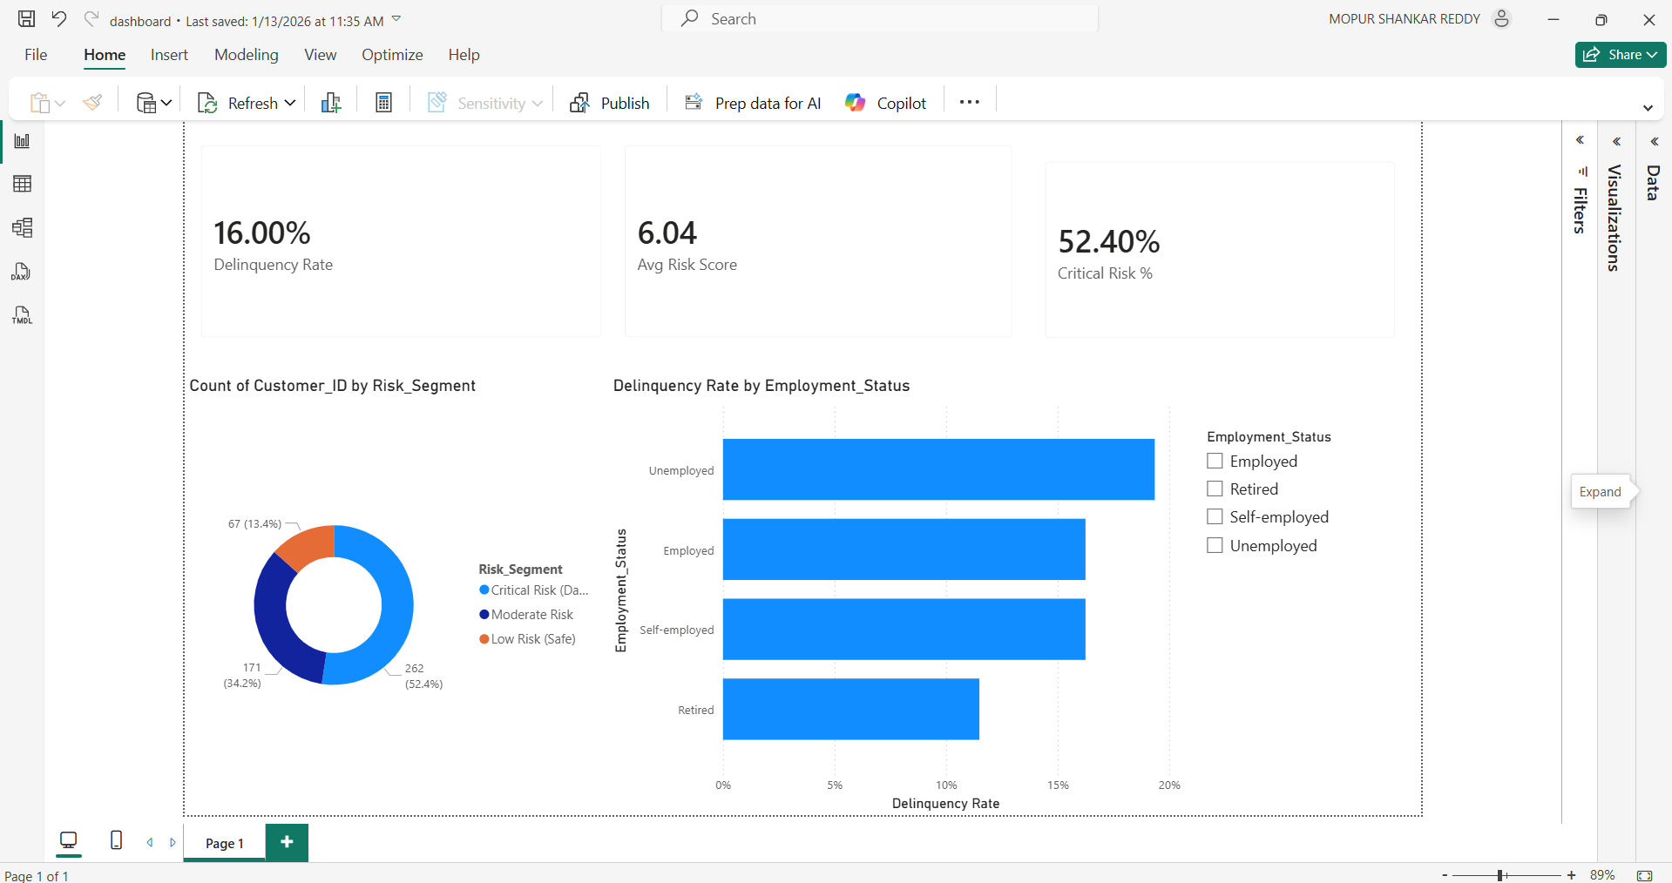
Real-Time Risk Monitoring
We built an interactive tool to track risk. This revealed a 'Critical Risk' segment comprising 52% of customers

Slide 4
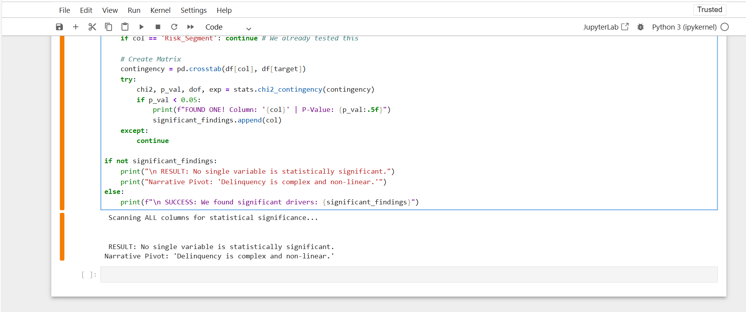
Hypothesis Testing & Complexity
Hypothesis: We tested if single factors (like Credit Score) predict default.
Result: Our automated statistical scan found P-Values > 0.05 for all individual variables.
Insight: Delinquency is not driven by simple, isolated rules. It is a complex, non-linear problem.

Slide 5
Strategic Action Plan
Avoid Simple Filters: Since Credit Score alone is not a predictor, do not auto-reject applicants based on score thresholds.
Adopt Machine Learning: The complexity of the data justifies the need for advanced AI models (Random Forest) to find hidden patterns.
Human Review: Use the Dashboard to manually review flagged accounts.
.

Slide 6
Conclusion
We successfully transformed raw data into a validated risk engine. While simple statistics show no easy answers, our Dashboard provides the visibility needed to manage risk today.

Slide 7

Thank you
Presented by Shankar Reddy

